Slide 1
CREATE TABLE IN HANA.
Milind Parab

Slide 2
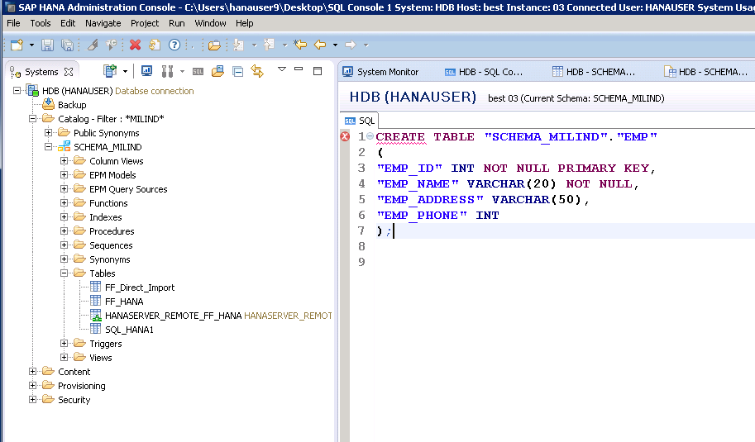
Create Table in HANA.

Slide 3
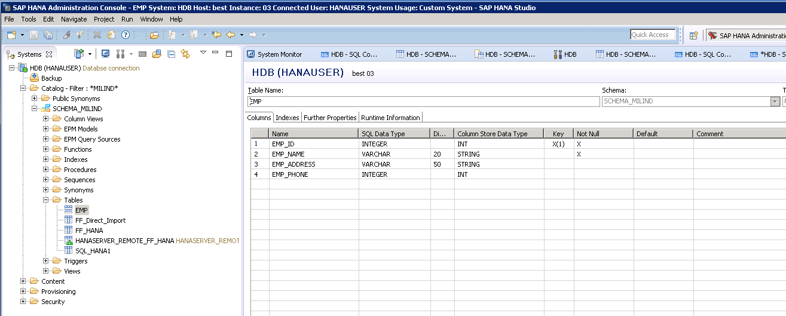
Table has been created.

